Slide 1
CoSc 333
Internet
and
Website Development
Instructor : Welde Janfa
Notes:
‹#›

Slide 2
Chapter 1 Introduction
Notes:
‹#›

Slide 3
OUTLINE
What is the Internet and its historical development
Protocols
Terminologies in the Internet
IP address,
Server and client relationship,
Internet Service Provider,
Domain name and Domain name service
‹#›
Notes:
‹#›

Slide 4
Internet
Internet is a global system of interconnected computer networks that use the standard Internet protocol suite (TCP/ IP) to serve billions of users worldwide.
It is a network of networks that consists of millions of
private, public, academic, business, and government networks, of local to global scope.
That are linked by a broad array of electronic, wireless and optical networking technologies.
The Internet carries a vast range of information resources and services, such as the interlinked hypertext documents of the World Wide Web (WWW) and the infrastructure to support electronic mail.
The Internet is most often used for three main purposes:
Communication
Buying and selling (e-commerce)
Searching for information
‹#›

Slide 5
Brief history Internet
Began as a US Department of Defense network called ARPANET (1960s-70s)
initial services: electronic mail, file transfer
opened to commercial interests in late 80s
WWW created in 1989-91 by Tim Berners-Lee
popular web browsers released: Netscape 1994, IE 1995
Amazon.com opens in 1995; Google January 1996
Hamster Dance web page created in 1999
‹#›

Slide 6
Protocol
Protocol
A protocol is a set of rules, used to retrieve a specific document.
The “http” in our URL refers to HyperText Transfer Protocol.
The “http” is followed by a colon and two forward slashes, then “www,” which refers to the World Wide Web.
human protocols:
“what’s the time?”
“I have a question”
introductions
… specific msgs sent
… specific actions taken when msgs received, or other events
network protocols:
machines rather than humans
all communication activity in Internet governed by protocols
‹#›

Slide 7
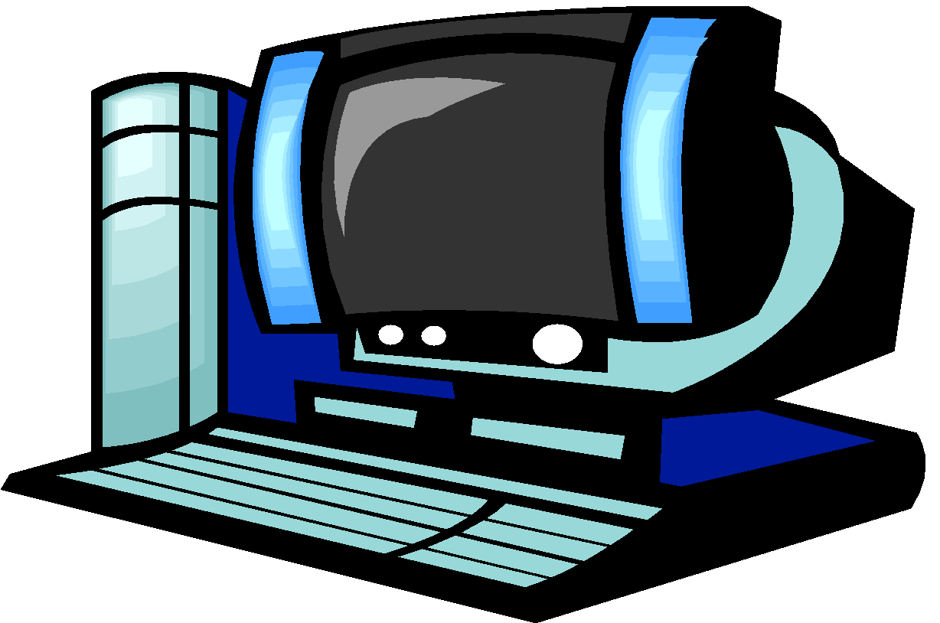


Protocol
a human protocol and a computer network protocol:
Hi
TCP connection
request
Hi
TCP connection
response
What is the
time?
Get http://www.awl.com/kurose-ross
2:00
<file>
‹#›

Slide 8
Protocol
An agreed upon convention for communication.
both endpoints need to understand the protocol.
Protocols must be formally defined and unambiguous!
Protocols define
format,
order of msgs sent and received among network entities,
actions taken on msg transmission, receipt
‹#›

Slide 9
Terminologies in the Internet
IP address
Internet: It might be helpful to think of the Internet as a vast system of roads all connecting to each other.
They do this through unique identification numbers called Internet Protocol Addresses (IP addresses).
Internet Service Provider (ISP)
Internet Service Providers are companies or organization that connect you to the Internet – for a fee, of course.
ISPs are available on a local, state, and national level.
Ex. EthioTelecom
‹#›

Slide 10
Terminologies in the Internet
Server and client relationship
How to access the Web? How to access the Web?
Once you have your Internet connection, then you need special software called a browser to access the Web.
Web browsers are used to connect you to remote computers, open and transfer files, display text and images.
Web browsers are specialized programs.
Examples of Web browser: Netscape Navigator (Navigator) and Internet Explorer
‹#›

Slide 11
Terminologies in the Internet
Server and client relationship
Client/Server Structure of the Web
Web is a collection of files that reside on computers, called Web servers, that are located all over the world and are connected to each other through the Internet.
When you use your Internet connection to become part of the Web, your computer becomes a Web client in a worldwide client/server network.
A Web browser is the software that you run on your computer to make it work as a web client.
‹#›

Slide 12
Terminologies in the Internet
Domain name
A domain name is a unique name associated with a specific IP address by a program that runs on an Internet host computer
The domain name consists of two parts.
In our example, “admas.edu” is the domain name. where “admas” is the host and “.edu” is the top-level domain.
This suffix indicates the type of organization to which the host belongs. As you can probably guess, “.edu” indicates that the host, “admas,” is an educational institution.
Common Top-Level Domains
.com Commercial or business websites, however anyone may use this now
.gov United States Government websites
.mil United States Military websites
.org Organizational websites (often non-profit organizations)
Directory/Page: The next part of the URL tells the web browser where to find the specific web page on the website.
‹#›
Notes:
‹#›

Slide 13
Terminologies in the Internet
Domain name service
This program, which coordinates the IP addresses and domain names for all computers attached to it, is called DNS (Domain Name System ) software.
The host computer that runs this software is called a domain name server
‹#›
Notes:
‹#›

Slide 14
TYPES OF INTERNET CONNECTIONS
There are five types of internet connections which are as follows:
Dial up Connection
Leased Connection
DSL connection
Cable Modem Connection
VSAT
‹#›
Notes:
‹#›

Slide 15
TYPES OF INTERNET CONNECTIONS
Dial up Connection
Dial-up refers to an Internet connection that is established using a modem.
The modem connects the computer to standard phone lines, which serve as the data transfer medium.
When a user initiates a dial-up connection, the modem dials a phone number of an Internet Service Provider (ISP) that is designated to receive dial-up calls. The ISP then establishes the connection, which usually takes about ten seconds and is accompanied by several beepings and a buzzing sound
Advantages
Low Price
Secure connection – your IP address continually changes
Offered in rural areas – you need a phone line
Disadvantages
Slow speed.
Phone line is required.
Busy signals for friends and family members.
‹#›
Notes:
‹#›

Slide 16
TYPES OF INTERNET CONNECTIONS
Leased Connection
Leased connection is a permanent telephone connection between two points set up by a telecommunications common carrier.
Typically, leased lines are used by businesses to connect geographically distant offices. Unlike normal dial-up connections, a leased line is always active.
The fee for the connection is a fixed monthly rate. The primary factors affecting the monthly fee are distance between end points and the speed of the circuit.
Advantage
Secure and private: dedicated exclusively to the customer,
Speed: symmetrical and direct
Reliable: minimum down time
Wide choice of speeds: bandwidth on demand, easily upgradeable
Leased lines are suitable for in-house office web hosting
‹#›
Notes:
‹#›

Slide 17
TYPES OF INTERNET CONNECTIONS
Leased Connection
Disadvantages
Leased lines can be expensive to install and rent.
Not suitable for single or home workers
Lead times can be as long as 65 working days
Distance dependent to nearest POP
Leased lines have traditionally been the more expensive access option. A Service Level Agreement (SLA) confirms an ISP’s contractual requirement in ensuring the service is maintained. This is often lacking in cheaper alternatives
‹#›
Notes:
‹#›

Slide 18
TYPES OF INTERNET CONNECTIONS
DSL /ADSL Connection
Digital Subscriber Line (DSL) is a family of technologies that provides digital data transmission over the wires of a local telephone network.
DSL originally stood for digital subscriber loop. In telecommunications marketing, the term DSL is widely understood to mean Asymmetric Digital Subscriber Line (ADSL), the most commonly installed DSL technology.
DSL service is delivered simultaneously with wired telephone service on the same telephone line.
The data bit rate of consumer DSL services typically ranges from 256 kbit/s to 40 Mbit/s in the direction to the customer (downstream), depending on DSL technology, line conditions, and service-level implementation.
‹#›
Notes:
‹#›

Slide 19
TYPES OF INTERNET CONNECTIONS
DSL /ADSL Connection
Advantages:
Security: Unlike cable modems, each subscriber can be configured so that it will not be on the same network
Integration: DSL will easily interface with ATM and WAN technology.
High bandwidth
Cheap line charges from the phone company.
Good for “bursty” traffic patterns
Disadvantages
No current standardization: Equipment might vary from place to place or when we change ISPs.
Expensive
Distance Dependence: The farther you live from the DSLAM (DSL Access Multiplexer), the lower the data rate. The longest run lengths are 18,000 feet, or a little over 3 miles.
‹#›
Notes:
‹#›

Slide 20
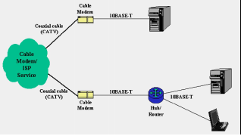
TYPES OF INTERNET CONNECTIONS
Cable Modem Connection
Cable Modem Connection A cable modem is a type of Network Bridge and modem that provides bi-directional data communication via radio frequency channels
Cable modems re primarily used to deliver broadband Internet access in the form of cable Internet, taking advantage of the high bandwidth
‹#›
Notes:
‹#›

Slide 21
TYPES OF INTERNET CONNECTIONS
Cable Modem Connection
Advantages
Always Connected: A cable modem connection is always connected to the Internet .
Bandwidth: Cable modems have the potential to receive data from their cable provider at speeds greater than 30 megabits per second.
File Transfer Capabilities: Downloads may be faster, but uploads are typically slower
Routing: Cable routers allow multiple computers to be hooked up to one cable modem, allowing several devices to be directly connected through a single modem. Wireless routers can also be attached to your cable modem
Disadvantage
Week signal strength over long distance .
Expansive
‹#›
Notes:
‹#›

Slide 22
TYPES OF INTERNET CONNECTIONS
VSAT
Used in satellite communications of data, voice and video signals, excluding broadcast television.
A VSAT consists of two parts,
A transceiver that is placed outdoors in direct line of sight to the satellite and
A device that is placed indoors to interface the transceiver with the end user’s communications device, such as a PC.
The transceiver receives or sends a signal to a satellite transponder in the sky.
The satellite sends and receives signals from a ground station computer that acts as a hub for the system
‹#›
Notes:
‹#›

Slide 23
TYPES OF INTERNET CONNECTIONS
VSAT
Advantages
Satellite communication systems have some advantages that can be exploited for the provision of connectivity. These are:
Costs Insensitive to Distance
Single Platform service delivery (one-stop-shop)
Flexibility , Upgradeable
Low incremental costs per unit
Disadvantage
High start-up costs
Higher than normal risk profiles
Severe regulatory restrictions imposed by countries that prevent VSAT networks and solutions
Some service quality limitations such the high signal delays (latency)
Natural availability limits that cannot be mitigated against
Lack of skills required in the developing world to design, install and maintain satellite communication systems adequately
‹#›
Notes:
‹#›

Slide 24
End of Chapter One Thank You
‹#›

Slide 25
Chapter 2 Internet Basics
Notes:
‹#›

Slide 26
OUTLINE
Advantage and disadvantage of the Internet
Virus and antivirus
‹#›
Notes:
‹#›

Slide 27
Advantage and disadvantage of the Internet
Internet has been the most useful technology of the modern times which helps us not only in our daily lives, but also our personal and professional lives developments.
The internet helps us achieve this in several different ways.
As a students and educational purposes the internet is widely used to gather information so as to do the research or add to the knowledge of various subjects
The internet has served to be more useful in maintaining contacts with friends and relatives who live abroad permanently
‹#›
Notes:
‹#›

Slide 28
Advantage of the Internet
E-mail: Email is now an essential communication tools in business. With e-mail you can send and receive instant electronic messages, which works like writing letters.
24 hours a day - 7 days a week: Internet is available, 24x7 days for usage.
Information: Information is probably the biggest advantage internet is offering.
There is a huge amount of information available on the internet for just about every subject, ranging from government law and services, trade fairs and conferences, market information, new ideas and technical support
Online Chat: You can access many ‘chat rooms’ on the web that can be used to meet new people, make new friends, as well as to stay in touch with old friends
‹#›
Notes:
‹#›

Slide 29
Advantage of the Internet
Services: Many services are provided on the internet like net banking, job searching, purchasing tickets, hotel reservations
Communities: Communities of all types have sprung up on the internet. Its a great way to meet up with people of similar interest and discuss common issues.
E-commerce: Along with getting information on the Internet, you can also shop online.
Entertainment: Internet provides facility to access wide range of Audio/Video songs, plays films.
Software Downloads: You can freely download innumerable, software like utilities, games, music, videos, movies, etc. from the Internet
‹#›
Notes:
‹#›

Slide 30
Disadvantage of the Internet
Theft of Personal information: Electronic messages sent over the Internet can be easily snooped and tracked, revealing who is talking to whom and what they are talking about.
If you use the Internet, your personal information such as your name, address, password, bank details and other information can be accessed by unauthorized persons.
Negative effects on family communication: It is generally observed that due to more time spent on Internet, there is a decrease in communication and feeling of togetherness among the family members.
Internet addiction: Some researchers, claim that it is simply people trying to escape their problems in an online world.
There is some controversy over whether it is possible to actually be addicted to the Internet or not
‹#›
Notes:
‹#›

Slide 31
Disadvantage of the Internet
Children using the Internet has become a big concern.
Virus threat: Computers getting viruses from the internet .
Virus is is a program which disrupts the normal functioning of your computer systems
‹#›
Notes:
‹#›

Slide 32
Virus and Antivirus
What is Computer Virus
A computer virus is a malicious piece of executable code that propagates typically by attaching itself to a host document that will generally be an executable file.
Computer viruses are small software programs that are designed to spread from one computer to another and to interfere with computer operation.
A virus might corrupt or delete data on your computer, use your e-mail program to spread itself to other computers, or even erase everything on your hard disk.
Viruses are most easily spread by attachments in email messages or instant messaging messages. That is why it is essential that you never open e-mail attachments unless you know who it's from and you are expecting it.
Viruses also spread through downloads on the Internet. They can be hidden in illicit software or other files or programs you might download
‹#›
Notes:
‹#›

Slide 33
Virus
Types of Viruses
Boot sector viruses
A boot sectors is a place where start up instruction is kept.
Since boot sector code is executed automatically, it is a common attack vector for viruses.
Program viruses
Executable files for system administration
Macro
Macros in documents are executable segments of code and are generally written in a language that is specific to each document type.
Documents that are allowed to contain macros (such as Microsoft Word documents, Excel spreadsheets, Access database files, etc.)
‹#›
Notes:
‹#›

Slide 34
Virus
Types of other than Viruses
Virus Hoaxes
Trojan Horses
Worms
Spam
Adware
Spyware
Malware
‹#›
Notes:
‹#›

Slide 35
Virus
What is an Anti-Virus?
Antivirus software is a class of program that searches a hard drive and floppy disk for any known or potential viruses.
Antivirus program runs in the Random Accesses Memory of a computer.
Anti-virus software typically uses two different techniques to accomplish this:
Examining files to look for known viruses by means of a virus dictionary.
Identifying suspicious behavior from any computer program which might indicate infection.
Most commercial anti-virus software uses both of these approaches, with an emphasis on the virus dictionary approach.
‹#›
Notes:
‹#›

Slide 36
Anti-Virus
What is an Anti-Virus?
Anti-virus is a software (computer program) that scans files or your computer's memory for certain patterns that may indicate an infection.
The patterns it looks for are based on the signatures, or fingerprints, of known viruses.
Once a virus is detected in the wild, the Anti-Virus companies then release these new patterns for your Anti-virus software to use.
The updates come out daily by some vendors. Virus authors are continually releasing new and updated viruses, so it is important that you have the latest definitions installed on your computer.
‹#›
Notes:
‹#›

Slide 37
Anti-Virus
Types an Anti-Virus?
There are two main types anti-virus
Anti-virus for personal computers.
Anti-virus for servers and others for enterprises
1st Reading Assignment
Read how anti-virus works and Type of virus and submit not more than two page about the topic.
‹#›
Notes:
‹#›

Slide 38
End of Chapter Two Thank You
‹#›

Slide 39
Chapter 3 Using Internet
Notes:
‹#›

Slide 40
OUTLINE
Email
The World Wide Web (WWW)
Search engines
‹#›
Notes:
‹#›

Slide 41
Email
E-mail or Electronic mail is a paperless method of sending messages, notes or letters from one person to another or even many people at the same time via Internet.
lt is an extremely popular means of communication.
It has become so integrated with the flow of our work and personal lives that it may be difficult to remember a time when we could not communicate this way.
E-mail is very fast compared to the normal post.
E-mail messages usually take only few seconds to arrive at their destination.
One can send messages anytime of the day or night, and, it will get delivered immediately.
‹#›
Notes:
‹#›

Slide 42
Email
Features of E-mail:
One-to-one or one-to-many communications
Instant communications
Physical presence of recipient is not required
Most inexpensive mail services, 24-hours a day and seven days a week
Encourages informal communications
Components of an E-mail Address
As in the case of normal mail system, e-mail is also based upon the concept of a recipient address.
The email address provides all of the information required to get a message to the recipient from any where in the world.
Consider the e-mail ID. welde@hotmail.com
In the above example welde is the username of the person who will be sending/receiving the email. Hotmail is the mail server where the username welde has been registered and com is the type of organization on the internet which is hosting the mail server.
‹#›
Notes:
‹#›

Slide 43
Email
Instant Messaging (IM) and Chat Rooms: These tools allow you to communicate with others who are online at the same time as you.
Podcasts: Podcasts are audio or video recordings available for download from the Internet. TV shows, newscasts, and instructor lectures are some examples of content that can be delivered via a podcast
Blogs: A blog (short for “web log”) is a public journal posted on the Internet. The word blog can be used as both a noun and a verb.
Social Networking: Social networking sites, such as Facebook, LinkedIn, Twitter, Flickr, and YouTube are convenient ways to meet new people, share photos and videos, connect with friends, and more.
Voice over Internet Protocol (“Voice over IP” or “VoIP”): This is a voice-based Internet communication solution that uses a standard Internet connection to place phone calls. Skype is an example of a software program that allows you to place calls over the Internet
‹#›
Notes:
‹#›

Slide 44
World Wide Web (WWW)
The Web (World Wide Web) consists of information organized into Web pages containing text and graphic images.
It contains hypertext links, or highlighted keywords and images that lead to related information.
A collection of linked Web pages that has a common theme or focus is called a Web site.
The main page that all of the pages on a particular Web site are organized around and link back to is called the site’s home page.
‹#›
Notes:
‹#›

Slide 45
Search engines
A Search Engine is a website that searches the World Wide Web for specific keywords, which you enter into a search field.
The search engine then displays a list of web pages that are somehow related to the keywords you entered.
You can then click the links to any of these web pages that interest you. Search results are not perfect. You may be looking for a specific website that does not appear right away.
Google (www.google.com) and Yahoo! (www.yahoo.com) are two popular search engines.
In summary, there are three basic ways to begin to surf the web:
Enter the URL of a website you want to visit
Use a Search Engine
Find your topic in a Subject Directory
* Remember that we have covered how the search engines work in our IR course
‹#›
Notes:
‹#›

Slide 46
End of Chapter Three Thank You
‹#›

